Slide 1

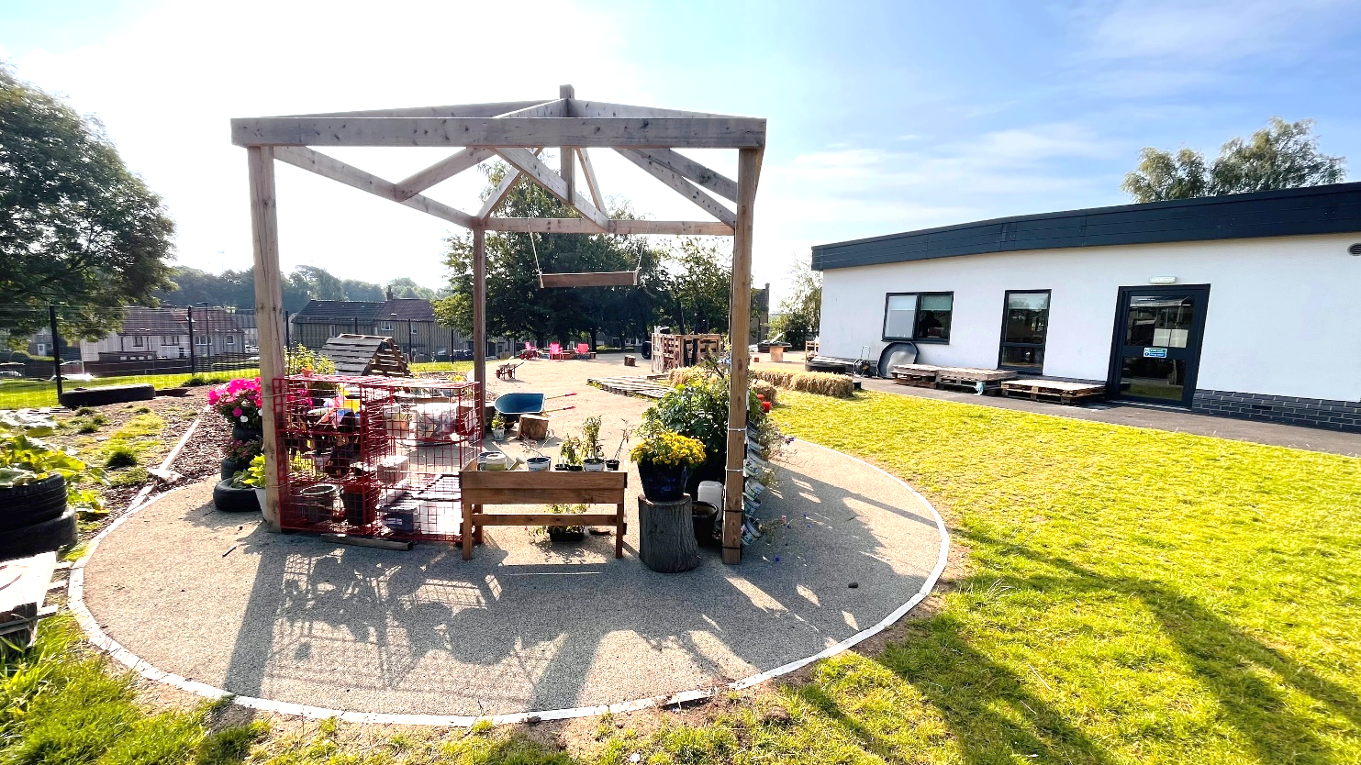
Welcome to
Inchlair Early Learning
and Childcare Centre
Falkirk Council
Children’s Services
Inchlair Early Learning & Childcare Centre
Valeview, Stenhousemuir, FK5 3BY
Tel: 01324 503430
Email: inchlairnurseryschool@education.falkirk.sch.uk
Head of Centre – Adele Hamilton
Website: www.inchlairelcc.co.uk
Bluesky: @inchlairelcc

Slide 2
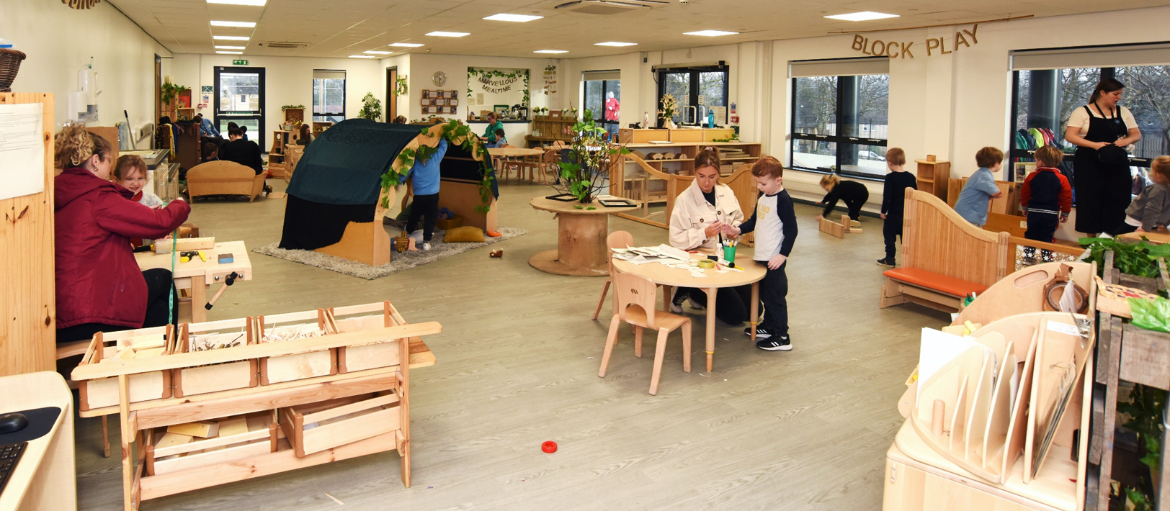
Inchlair Early Learning & Childcare Centre
We would like to welcome you and your family to Inchlair Early Learning & Childcare Centre.
We are pleased you have chosen to use our service and hope that your time spent with us will be a happy experience.
This handbook is designed to provide information about the centre and hopefully answer any questions you may have. However please feel free to approach any member of staff if you require more information.
Myself and the team look forward to working in Partnership with you and your family. We aim to provide a high quality service for children and their families.
We will communicate with you throughout the year via monthly newsletters, celebrations of family learning events, Bluesky, formal and informal meetings. We also display information on the nursery notice boards.
Inchlair Early Learning & Childcare Centre is committed to working in Partnership with families. We aim to provide a high quality service for children and their families.
Adele Hamilton
Head of Centre

Slide 3
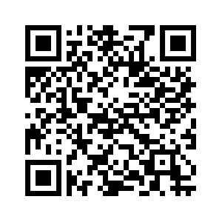
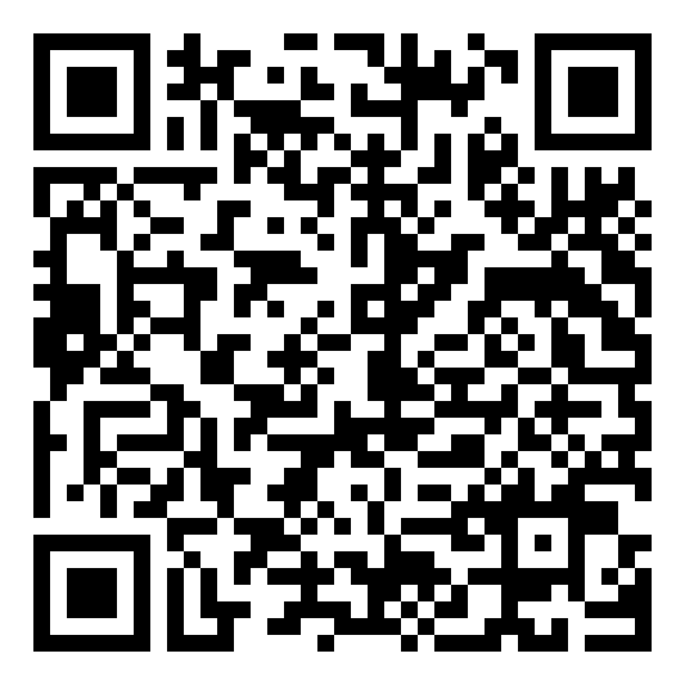
All 3 and 4 year olds, and eligible 2 year olds, in Scotland have a statutory entitlement to up to 1140 hours of funded early learning and childcare in each year of their entitlement.
Early Learning and Childcare is available for 5 days per week. The ELC Centre is open 8 am to 6 pm Monday to Friday and is open all year except bank holidays, in-service days and in between Christmas and New Year.
The Centre offers flexible childcare for a core of 30 hours per week (term time) or 23 hours and 20 minutes on a full year contract. Additional wrap around hours can also be purchased if capacity allows. Children are provided with a healthy snack and a 2 course lunch during each session.
More information on Falkirk Council Early Years can be found on their website https://www.falkirk.gov.uk/early-learning
Families are requested in the interest of Health and Safety to arrive and collect children at the agreed times, as staffing is organised around expected numbers of children.
We also have access and links with Social Work, Health Visitors, Educational Psychologist, Bilingual Support, Occupational & Physiotherapists and Speech & Language Therapy Services and various other agencies. There may be occasions when we will discuss your child’s development with these professionals if deemed appropriate for their health & well-being.
We are Falkirk’s First Froebel Flagship Nursery. Our aim is to ensure that all children in our settings have access to high quality early learning through a range of experiences which are based on the principles of Friedrich Froebel, the creator of kindergarten. Froebel believed that children learn through ‘doing’ therefor we are providing real life experiences through core provision eg. Marvellous Meals, Block Play, Creativity, Clay, Sewing and Engaging with Nature.
Our team is made up of:
Adele Hamilton Head of Centre
Claire Lord Principal Early Years Officer
Shirley Couser Senior Early Years Officer
Linda Love Senior Early Years Officer
Karen Leitch Clerical Assistant
20 Early Years Officer’s
2 Support for Learning Assistants
3 Early Learning & Childcare Assistants
2 Kitchen Assistants
3 Cleaners
If you would like to learn more about Froebelian practice or our own Frobelian principles. Please use the QR codes provided, where you will find a range of downloadable Froebel Trust pamphlets, packed with practical ideas for anyone who cares for young children.

Slide 4
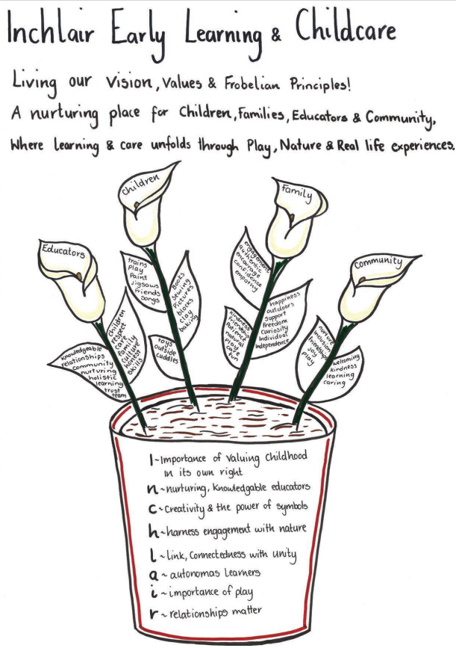
Our Vision, Values & Frobelian Principles
Living our Vision, Values & Frobelian Principles!
A nurturing place for Children, Families, Educators & Community. Where learning & care unfolds through Play, Nature & Real Life Experiences.

Slide 5
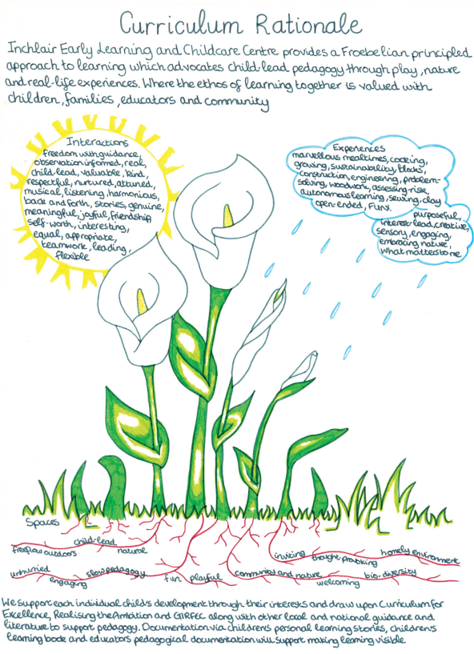

Slide 6
Importance of Play
“Play is the highest expression of human development in childhood for it alone is the free expression of what is in a child’ soul” (Friedrich Froebel)
Learning through play is widely acknowledged as a key component of good practice in Early Years. Here at Inchlair ELC Centre we value the importance of play based learning experiences. During play children naturally engage in a wide range of curricular areas. Our educators, by observing and evaluating play, provide suitably challenging experiences which further develop the child’s skills and outcomes within the curriculum. We ask open-ended questions and provocations to further enhance, scaffold or deepen each child’s interests in order to provide high quality learning opportunities. Through this the children become autonomous learners.
Creativity
Having the opportunity to take part in creative experiences is extremely important for a child's development. It provides children with an exciting tactile and sensory experience that inspires their curiosity, allows them to explore the world around them and enhances their learning, language and creativity. In order for them to take full advantage of these experiences it is best that your child wear older clothes. It is advisable too, that you provide a change of clothes and underwear to be kept at nursery. Please label all clothing clearly with your child’s name
Play With Risk
Taking part in play which involves safe risk taking, both indoors and outdoors, is essential for children to develop mentally and physically. They learn about their own capabilities whilst working out ways to solve problems, develop balance and coordination and nurture their curiosity. Most importantly, they will build on their emotional resilience through trial and error as they play and learn.
Loose Parts
Loose Parts are resources including items such as, wooden planks, bricks, pallets, drum reels, cardboard boxes, tyres, bread baskets, tarpaulins and plastic guttering. These can be used in many different ways, allowing children to use their imagination to make anything from a pirate ship or castle to an assault course or a den. Loose Part Play will happen throughout the day, both indoors and outdoors. It provides opportunities for children to investigate, discover, explore, problem solve and risk assess as they create. Educators work closely with the children to minimise risks, however, we are aware that bumps and scrapes may occur as part of the learning process. Procedures have been put in place to help minimise risk. Our educators involve the children in discussions about health and safety issues including how to use resources safely. All resources are checked daily for suitability and safety and educators receive additional training to further support children’s play

Slide 7

Outdoor Learning Experiences
Dressing for the weather The Health and Social Care Standards: My Support My Life, requires that all children have the opportunity to play outdoors every day. Outdoor learning experiences are known to play a crucial part in cognitive development as well as physical and emotional development. Here at Inchlair ELC Centre the children have access to outdoors every day regardless of the weather. Children are encouraged to wear protective clothing such as waterproof jackets and wellies. However they will not be stopped from accessing the outdoors if they choose not to wear them. This means that their own clothes may get wet, dirty or muddy. We have a selection of clothing and footwear to enable the children to fully take part in wet weather activities. If you wish to supply your own child’s wellies and waterproofs, please ensure they have their name clearly written on each item.
The Peep Learning Together Programme (LTP) is a parent and child group which is for anyone who is looking for some increased knowledge and confidence in how to support their child's learning and play in their day to day life. It values and extends what parents/carers already do to support their child’s learning. Linda Love is our trained Lead Practitioner in PEEP. The programme revolves around conversations and joint activities focusing on aspects of children’s learning and development. Peep sessions model how singing, talking, playing and sharing books and stories together help strengthen relationships and develop children’s listening, talking and later literacy.
Family Partnership
We recognise and acknowledge that families are the most important people in a child’s life. We aim to work in partnership with families and will at all times, ensure that you are involved in decisions affecting the care and education of your child.
Please remember that you are welcome at any time to remain with your child in the centre. All staff actively encourage and greatly appreciate parental involvement.
We currently have opportunities for families to attend ‘Stay ‘n’ Play and Woodland Walks with your children. Our PEEP Group and Baby Massage Classes meet weekly for a block of 6 weeks and weekly Bookbug sessions are available for you & your children. Please look out for days and times.
If you have any talents/interests you would like to share with us e.g. gardening, cooking, woodwork etc. we would love you to become involved.
Your comments and suggestions about our service delivery or ideas and offers of help with projects within the centre would be very welcome.

Slide 8
Support for Learning Assistant/Early Learning & Childcare Assistants
We have Support for Learning Assistants (SfLA) and Early Learning Childcare Assistants (ELCA’s) who will work alongside our EYO’s supporting our children with additional support needs, during lunch periods and throughout children’s experiences. They are a valuable support, working closely with Keyworker’s and other professionals involved.
Recording Your Child’s Progress
Each child has a ‘Learning Journal’. Staff will write learning stories to monitor and celebrate your child’s progress. Families and children are encouraged to read and help complete these. Recording of progress is both within and out with the centre.
Reviewing of Placement
Children’s progress is reviewed initially after 12 weeks and then approximately every 6 months. Parent/carer, child’s keyworker and where appropriate any other professional’s involved with the family meet to discuss your child’s progress and suitability of placement etc. Parents/carers may call a review before 6 months if required.
Marvellous Meals
In line with current legislation and policy we follow the current nutritional guidelines, Setting the Table and Marvellous Meals.
Meal times should be a happy, relaxed and sociable event for all children. We actively encourage children to be independent and make choices. Children will be given opportunities daily to prepare their own snacks, bake and to choose snack menus.
Snack will be offered morning and afternoon with fresh fruit. Lunch consists of a 2 course lunch. Water will be on offer throughout the day. The menu will be on display daily and we encourage you to support your child to self register for lunch. If your child has any special dietary requirements we require a letter from your GP.

Slide 9
Safety and Security
Entry System and Signing In Procedure
On entry please press the buzzer for reception, please stand in front of the buzzer when you press to allow us to see you as there is a camera situated in the buzzer. On hearing the buzzer please pull the door towards you. To ensure this system is effective, we ask that you do not hold the door open for any person unless a member of staff is present or you know they are a parent with a child attending the Centre. On entering and leaving the building please ensure the door is closed securely.
In the playroom we ask that you sign your child in and out daily. Please enter your child’s name and state their time of arrival and who will be returning to collect them, and time they leave. You may find the above system time consuming but we are sure you will appreciate the necessity in ensuring the safety of all. In the event of an emergency evacuation the signing in sheets will be used to provide details of who is in the building.
On leaving the building you should press the green release button on the right hand side of the door. PLEASE DO NOT allow children to press this button for the safety of your child, and other children within the centre, we DO NOT want them opening the door unsupervised.
Collection of Children
Parents/carers must inform staff who will collect their child. Staff will not release any child without parental consent or to anyone who we feel is not a responsible adult. Please note – any person collecting a child should be 16 years + and have identification and no one under the influence of alcohol or drugs.
Accidents and First Aid
We have several members of staff who are qualified First Aider’s who are available throughout the day. From time to time children will have accidents in the centre. Basic First Aid will be administered and families will be informed. In the event that medical treatment is required every effort will be made to contact you, and arrangements made to enable you to accompany your child. In the event we are unable to contact you or your emergency contact we may be required to seek medical support. All accidents are recorded in an accident book. You will also be asked to sign an accident form; this is kept as a record you have been informed.
If for any reason your child sustains an accident and this is not reported to you, please inform us. We ask if your child sustains an injury that has happened at home that you inform staff.

Slide 10
Sickness and Medical Conditions
To minimise the risk of the spread of infection, it is our policy that any child who has an infectious illness must stay at home. In the interest of the health, safety & wellbeing of children and staff we ask that you inform staff immediately if your child is diagnosed with any infection or common childhood ailments e.g. chicken pox, measles, mumps, Covid etc. Please note if your child has sickness and/or diarrhoea they must have 48 hours clear before returning to centre. Should your child suffer from a recurring medical condition or allergy e.g. eczema, hay fever, nut allergy or asthma, we ask that you inform staff of any symptoms your child experiences and how these are normally dealt with.
Medicines
Centre staff can only administer medication prescribed by a doctor. All medication (including medication for illness such as epilepsy or asthma etc.) should have the prescription label showing the child’s name, clear instructions of dosage and a signed consent form from the parents/carers stating what dose is to be administered. Staff are unable to give the first dose of a new medication. Parents/carers must give the first dose to ensure the child does not have an adverse reaction. After the first dose has been given at home, staff will be vigilant when administering a second dose of a new medication as this is when a more serious reaction could occur. Ideally parents/carers should give the first 2 doses of a new medication prior to centre staff administering.
Medicines should be handed to an appropriate member of staff. All medication will be stored out of reach of children and in their own box. Medication requiring to be stored in the fridge out-with the playroom therefore please remember to ask for it at the end of the day. Your child’s medication will be signed in and out daily by both parent/carer and member of staff. Medication will only be administered by a permanent member of staff. All medication will be double checked by another member of staff before being administered to the child.

Slide 11
Medicine – cont’d
Medical Care Plans
Some children who have medical conditions may require a medical care plan. This will be completed by a senior member of staff in partnership with parents/carers and other relevant health professionals. The medical care plan will be available in your child’s playroom at all times and will be updated regularly. If your child has any changes to medication, please inform us immediately.
Choking
In the interest of children’s safety can we request that children do not bring small toys, balloons, lollipops etc. as they are choking hazards.
Child Protection
We adhere to Falkirk Council’s Child Protection Policy and have a duty to follow the Procedures for reporting any cause for concern regarding any child. It is therefore advised that you explain to staff any suspicious looking injuries. We are well aware of everyday bruising and do not mean to cause alarm but we must follow policies to protect children.
Infection or Symptom's | Recommended Exclusion
Chickenpox (Varicella Zoster) | Until all vesicles have crusted over (usually 5 days)
Hand Foot and Mouth (Coxsackie) | None
Impetigo (Streptococcal Group A skin infection) | Until lesions are crusted or healed or 48 hours after starting antibiotics
Scarlet Fever | Child can return 24 hours after starting appropriate antibiotic treatment
Slapped Cheek/Fifth Disease (Parvovirus B19) | None (once rash has developed)
Diarrhoea and/or Vomiting | 48 hours from last episode of diarrhoea or vomiting
Flu (Influenza) | Until recovered
Whooping Cough (Pertussis) | 48 hours from starting antibiotic treatment or 21 days from onset of illness if no antibiotic treatment
Conjunctivitis | None

Slide 12
Confidentiality
At all times this is adhered to with all members of staff – therefore anything discussed between parents/carers and staff is in confidence. If confidential information is passed onto a member of staff it is their duty to inform senior management.
Depending on the nature of the confidential information e.g. Child Protection, it may be deemed appropriate to pass that information on to a more appropriate person. You will be advised of this where possible.
Absences
It is now Falkirk Council’s policy that if your child is going to be absent from the centre you must telephone us. If we do not hear from you, we will contact you. For contact in an emergency it is also important that you inform staff if you will not be at your usual contact number during centre hours (e.g. if you should have a day off work or training etc.).
Sunscreen
As we all know it is important to protect from exposure to the sun not only to avoid sunburn in early life but also to protect against skin cancer in adult life. During the warmer months it is advisable that you provide a sun hat with your child’s name on and that their shoulders are covered at all times. Please make sure they have sun cream applied before arriving for their session and we will reapply throughout the day. We have a supply of sun cream at nursery but if you would prefer we use your own, please clearly label the bottle with your child’s name before handing it over to staff. It is our policy not to allow children outdoors without sun cream being applied. We also recommend children play indoors between 11 am and 3 pm on very hot days.
Head Lice
This is an intermittent problem and we will give you regular reminders but we do recommend that a weekly head check is carried out. For further information and advice, please speak to your child’s Keyworker or Health Visitor.
Breast Feeding
We are a breast feeding friendly centre, have a suitable room for breast feeding and we also have the facility to store expressed breast milk.

Slide 13
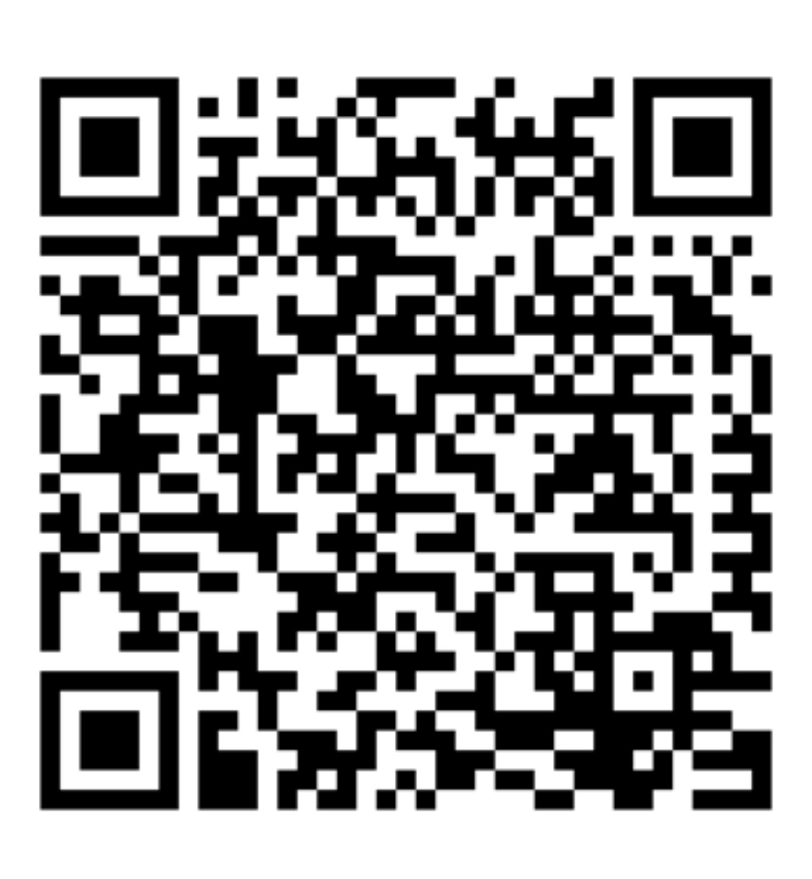
Website/Bluesky/Centre Newsletter www.inchlairelcc.co.uk
In an effort to keep families up to date with ‘centre life’ we have a website which will give you up to date and current information with regards to experiences that children are participating in, inspection reports, closure dates.
Our newsletter ‘Nursery Times’ comes out monthly and can also download this from the website. The newsletter is emailed to parents/carers at the beginning of the month, paper copies are also available.
We are also on Bluesky, @inchlairelcc our website has the link on the home page.
Bilingual/Interpreter Support Service
If this service is required, please do not hesitate to speak to a member of staff. Support staff are available to families and children. Our brochure can also be printed in families first language.
Quality Assurance
We are reflective of our work practice and striving to improve the service we provide. We review our policies timely & we ask that families help with this. We will display our policies on our website & advise through our newsletter when we have updated them. If you wish to comment, we would welcome your feedback.
Self-evaluation is also part of our Quality Assurance and we do this in a variety of ways including: audits, questionnaires, consultation etc. We involve children, families, staff and other stakeholders and again we value & appreciate your feedback.
If you have a complaint regarding the centre, please speak to a senior member of staff in the first instance. If, however you are not satisfied with the outcome you can make a formal complaint through: - Falkirk Council Complaints Procedure: https://www.falkirk.gov.uk/contact-us/complaints-procedure
Falkirk Council
School Holiday Dates

Slide 14
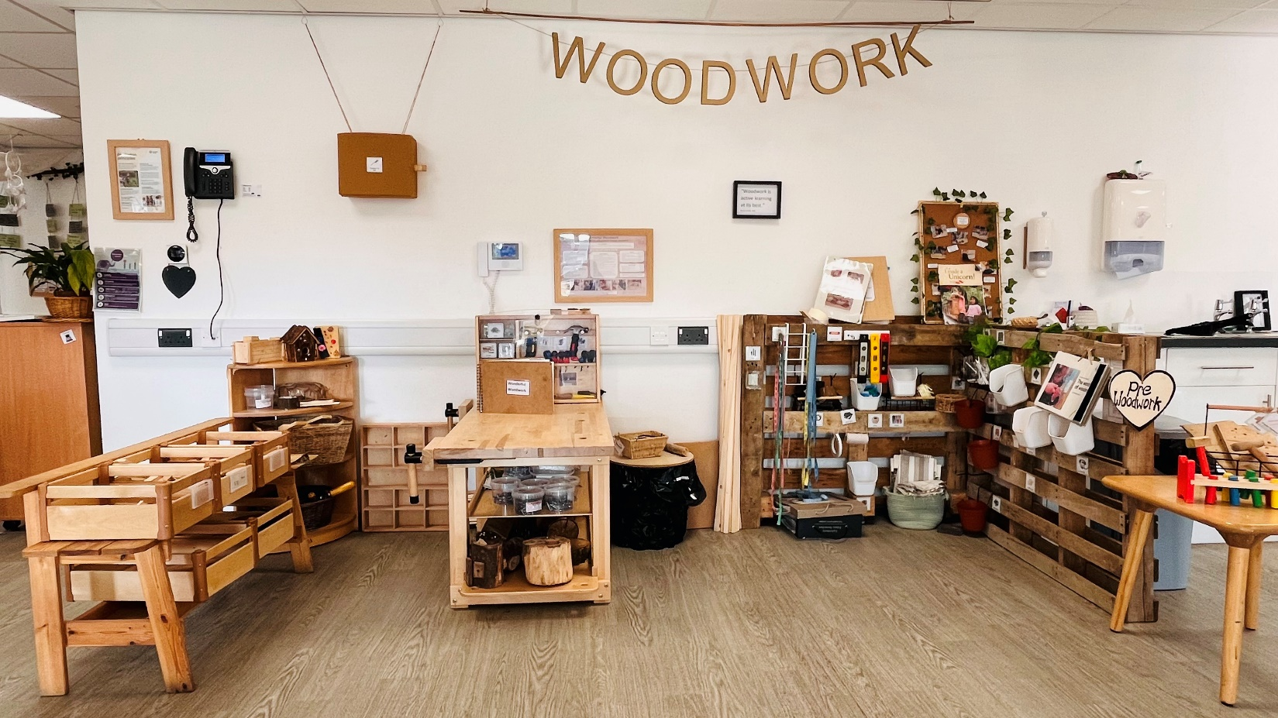
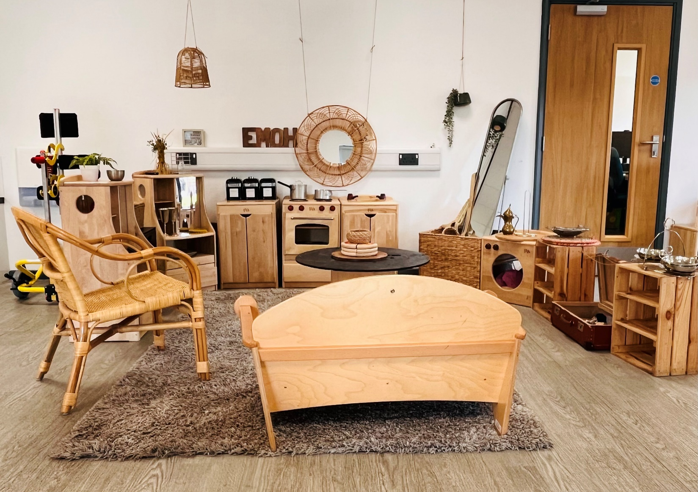
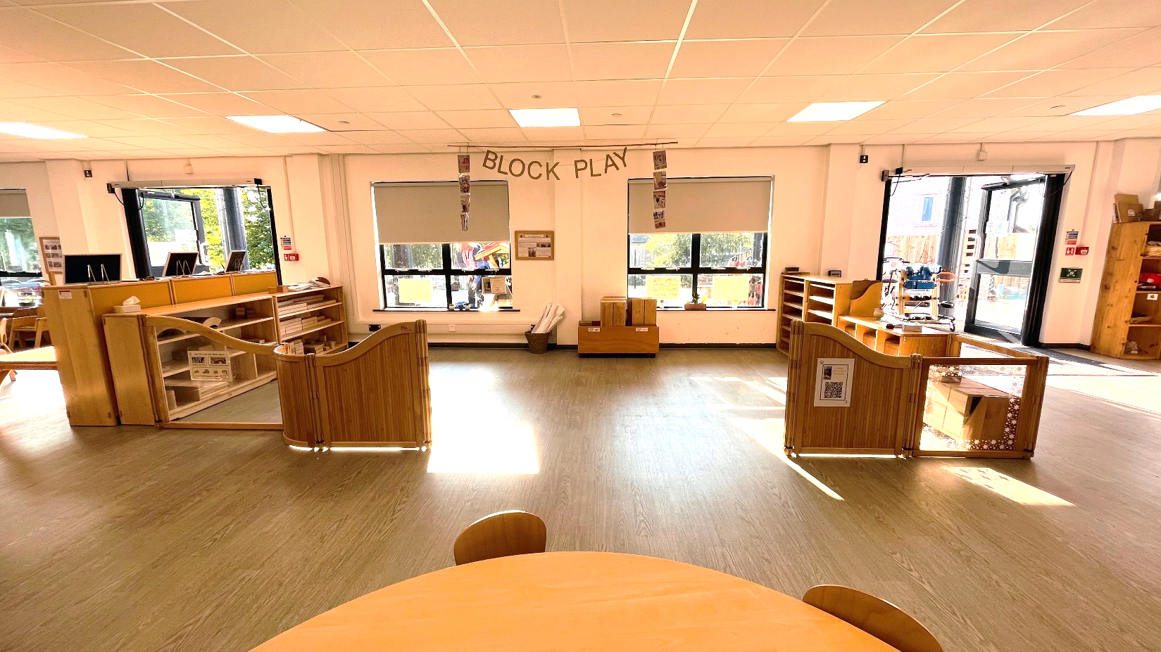
We are inspected regularly by the Care Inspectorate; this service is totally independent of the centre. During the inspection process the Care Inspector will be available to speak to families. This will give you an opportunity to comment on the service the centre provides. Inspections from the Care Inspectorate are all unannounced.
A copy of the Inspection Report is available on our website.
We are also inspected by Falkirk Council Children’s Services and Education Scotland (formally known as HMIe).
You may also contact the Care Inspectorate at any time throughout the year. Contact Details: Care Inspectorate
Compass House
11 Riverside Drive
Dundee DD1 4NY
Tel: 01382 207100

