Slide 1


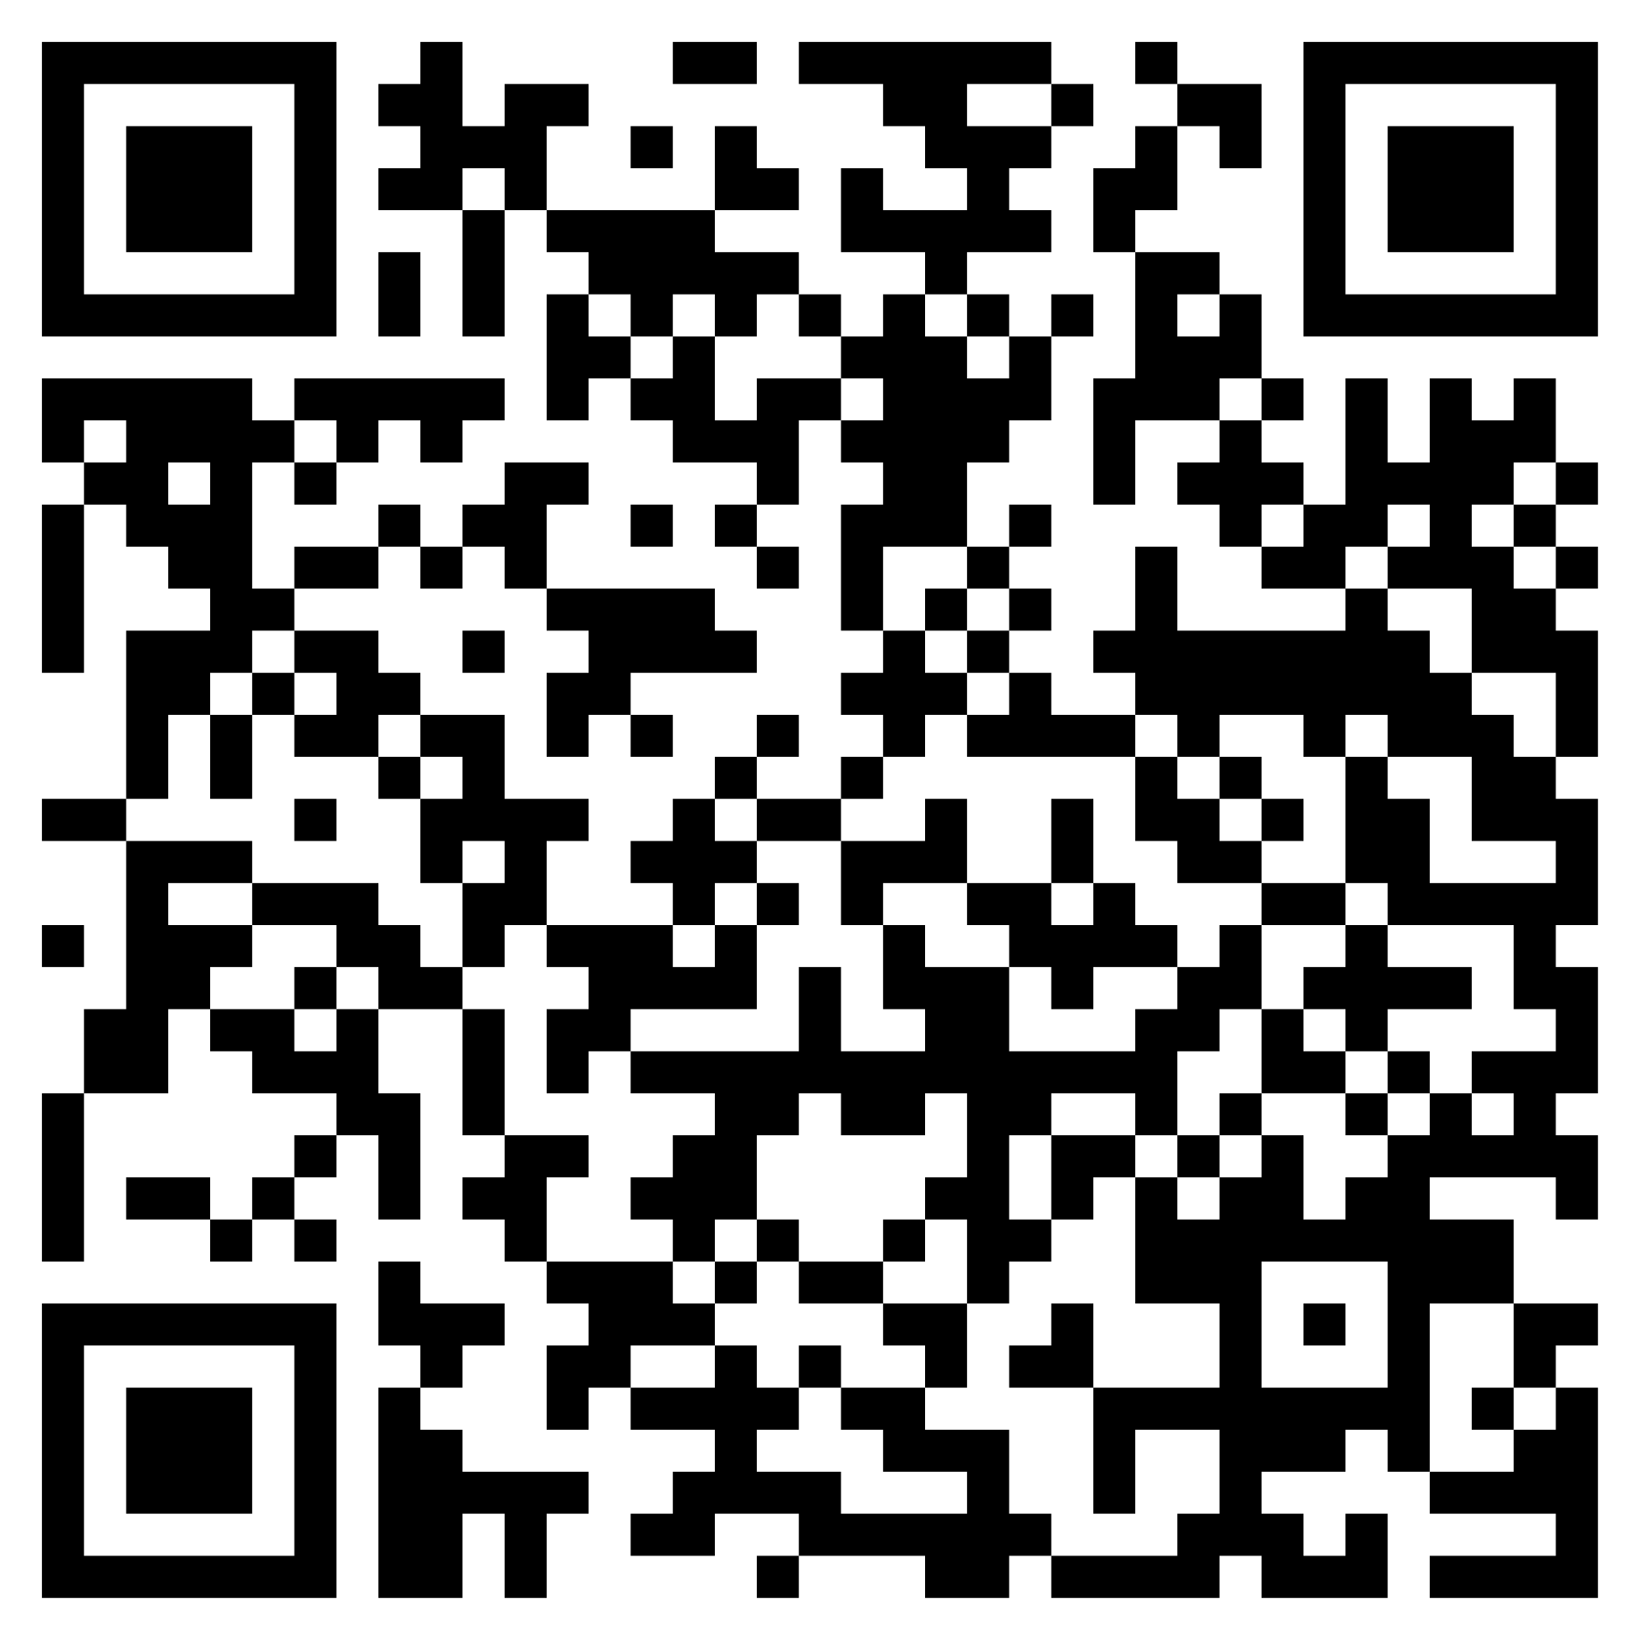

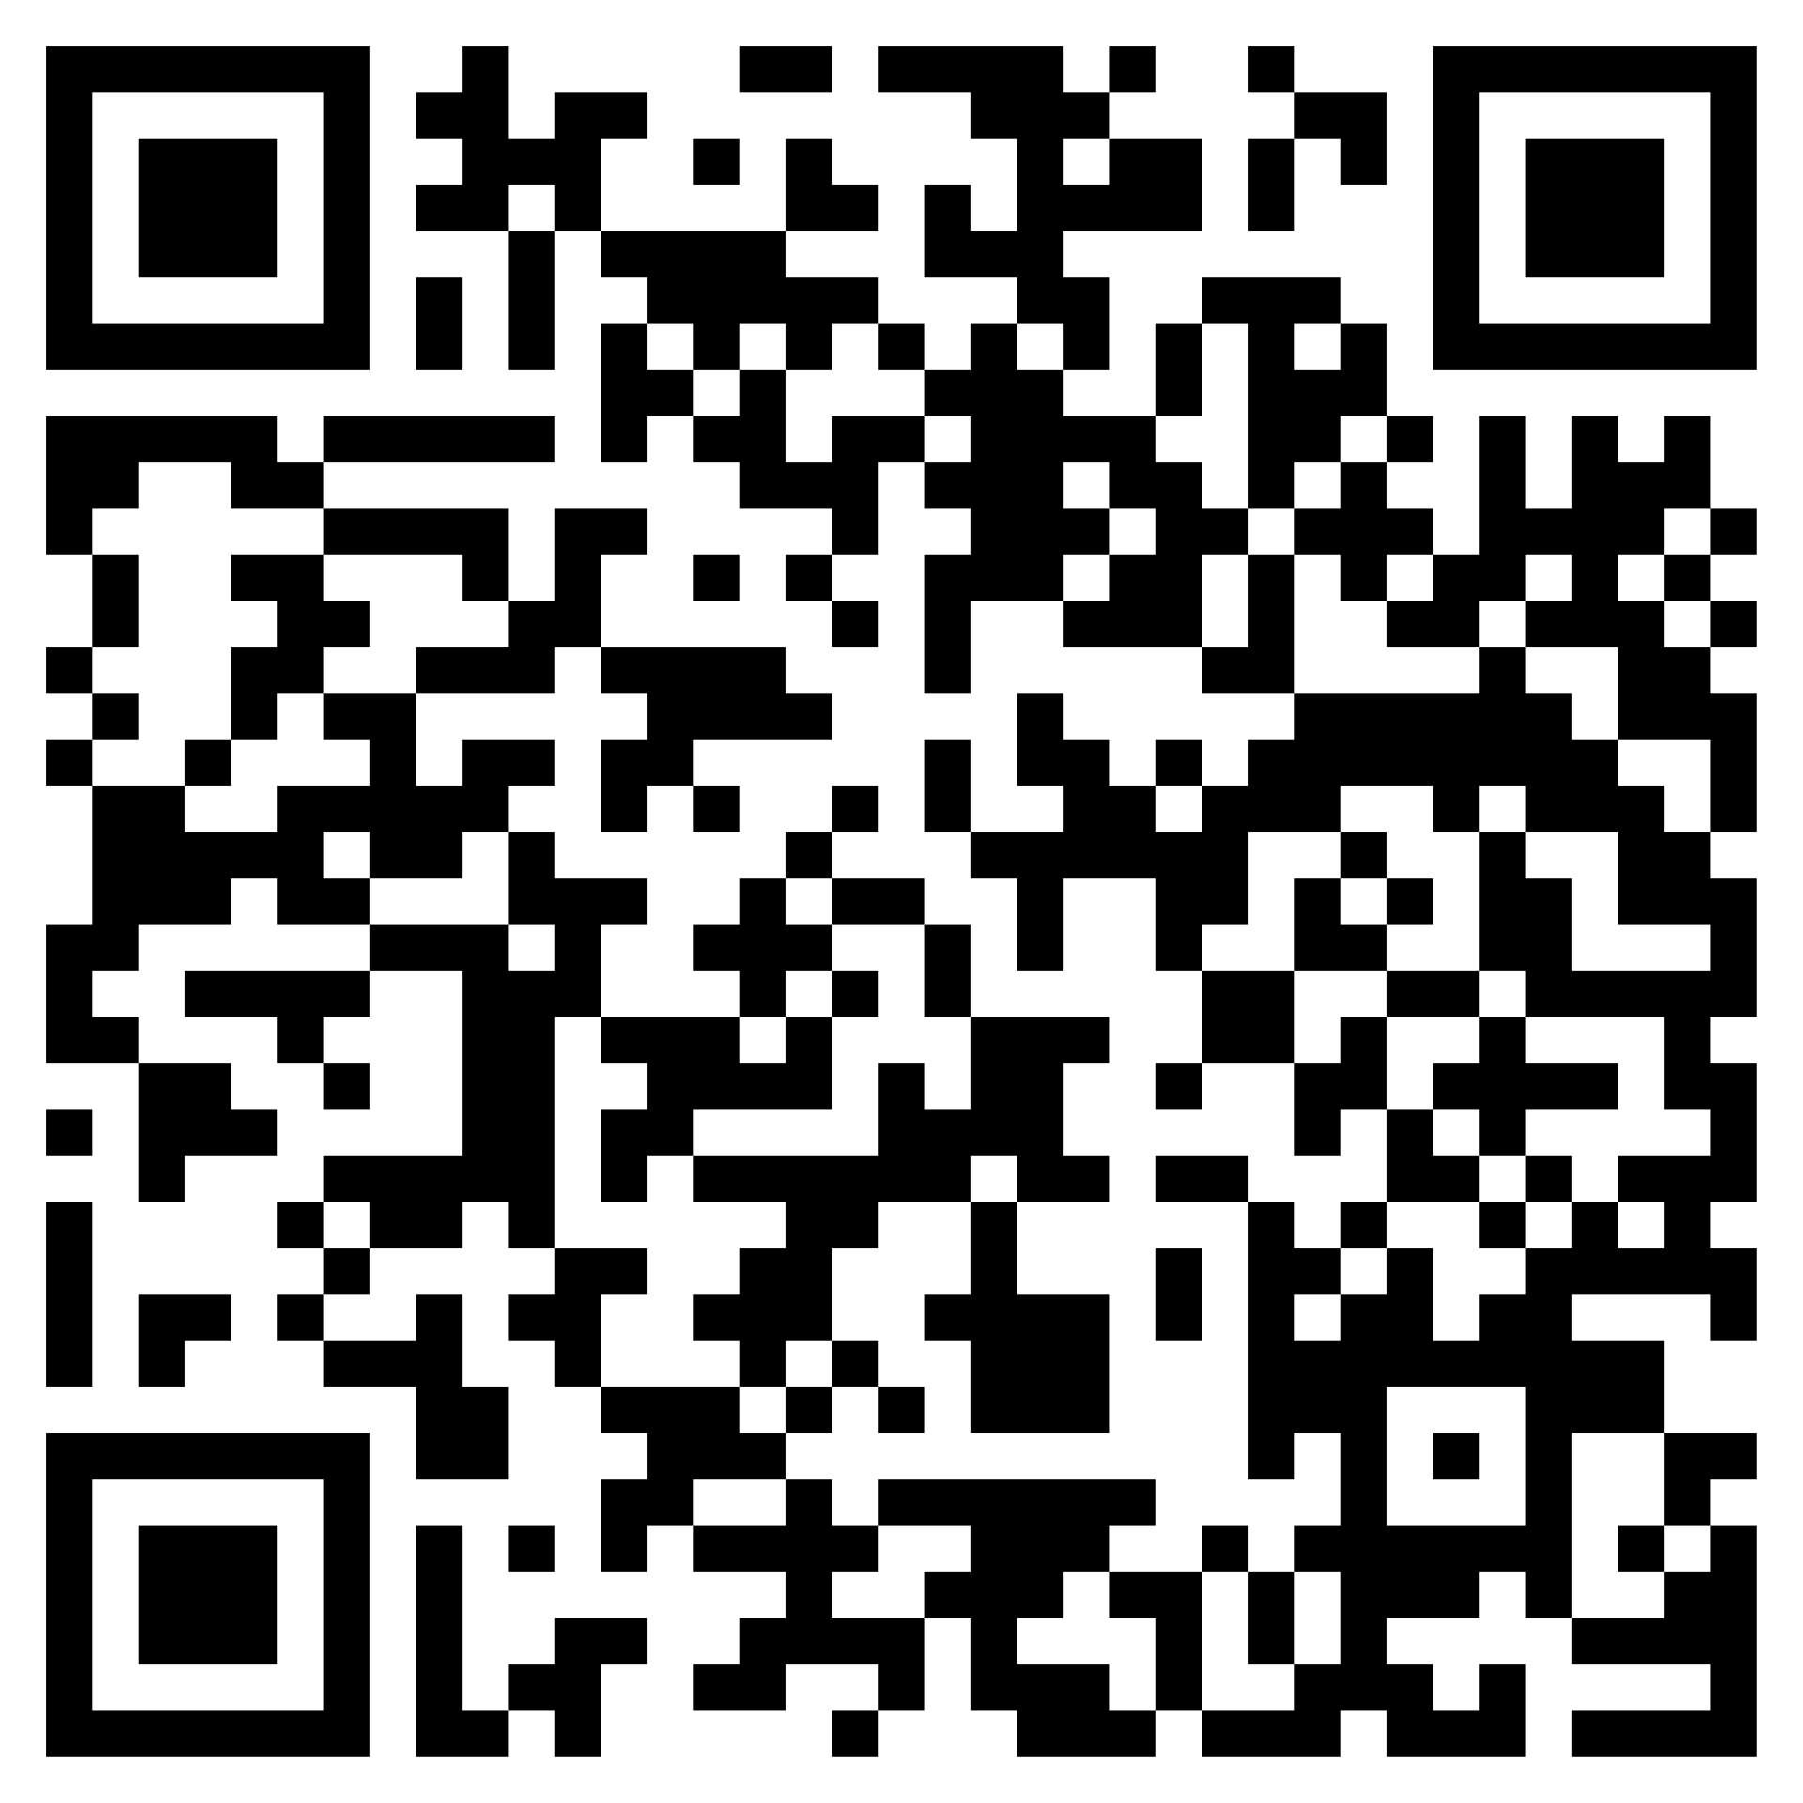
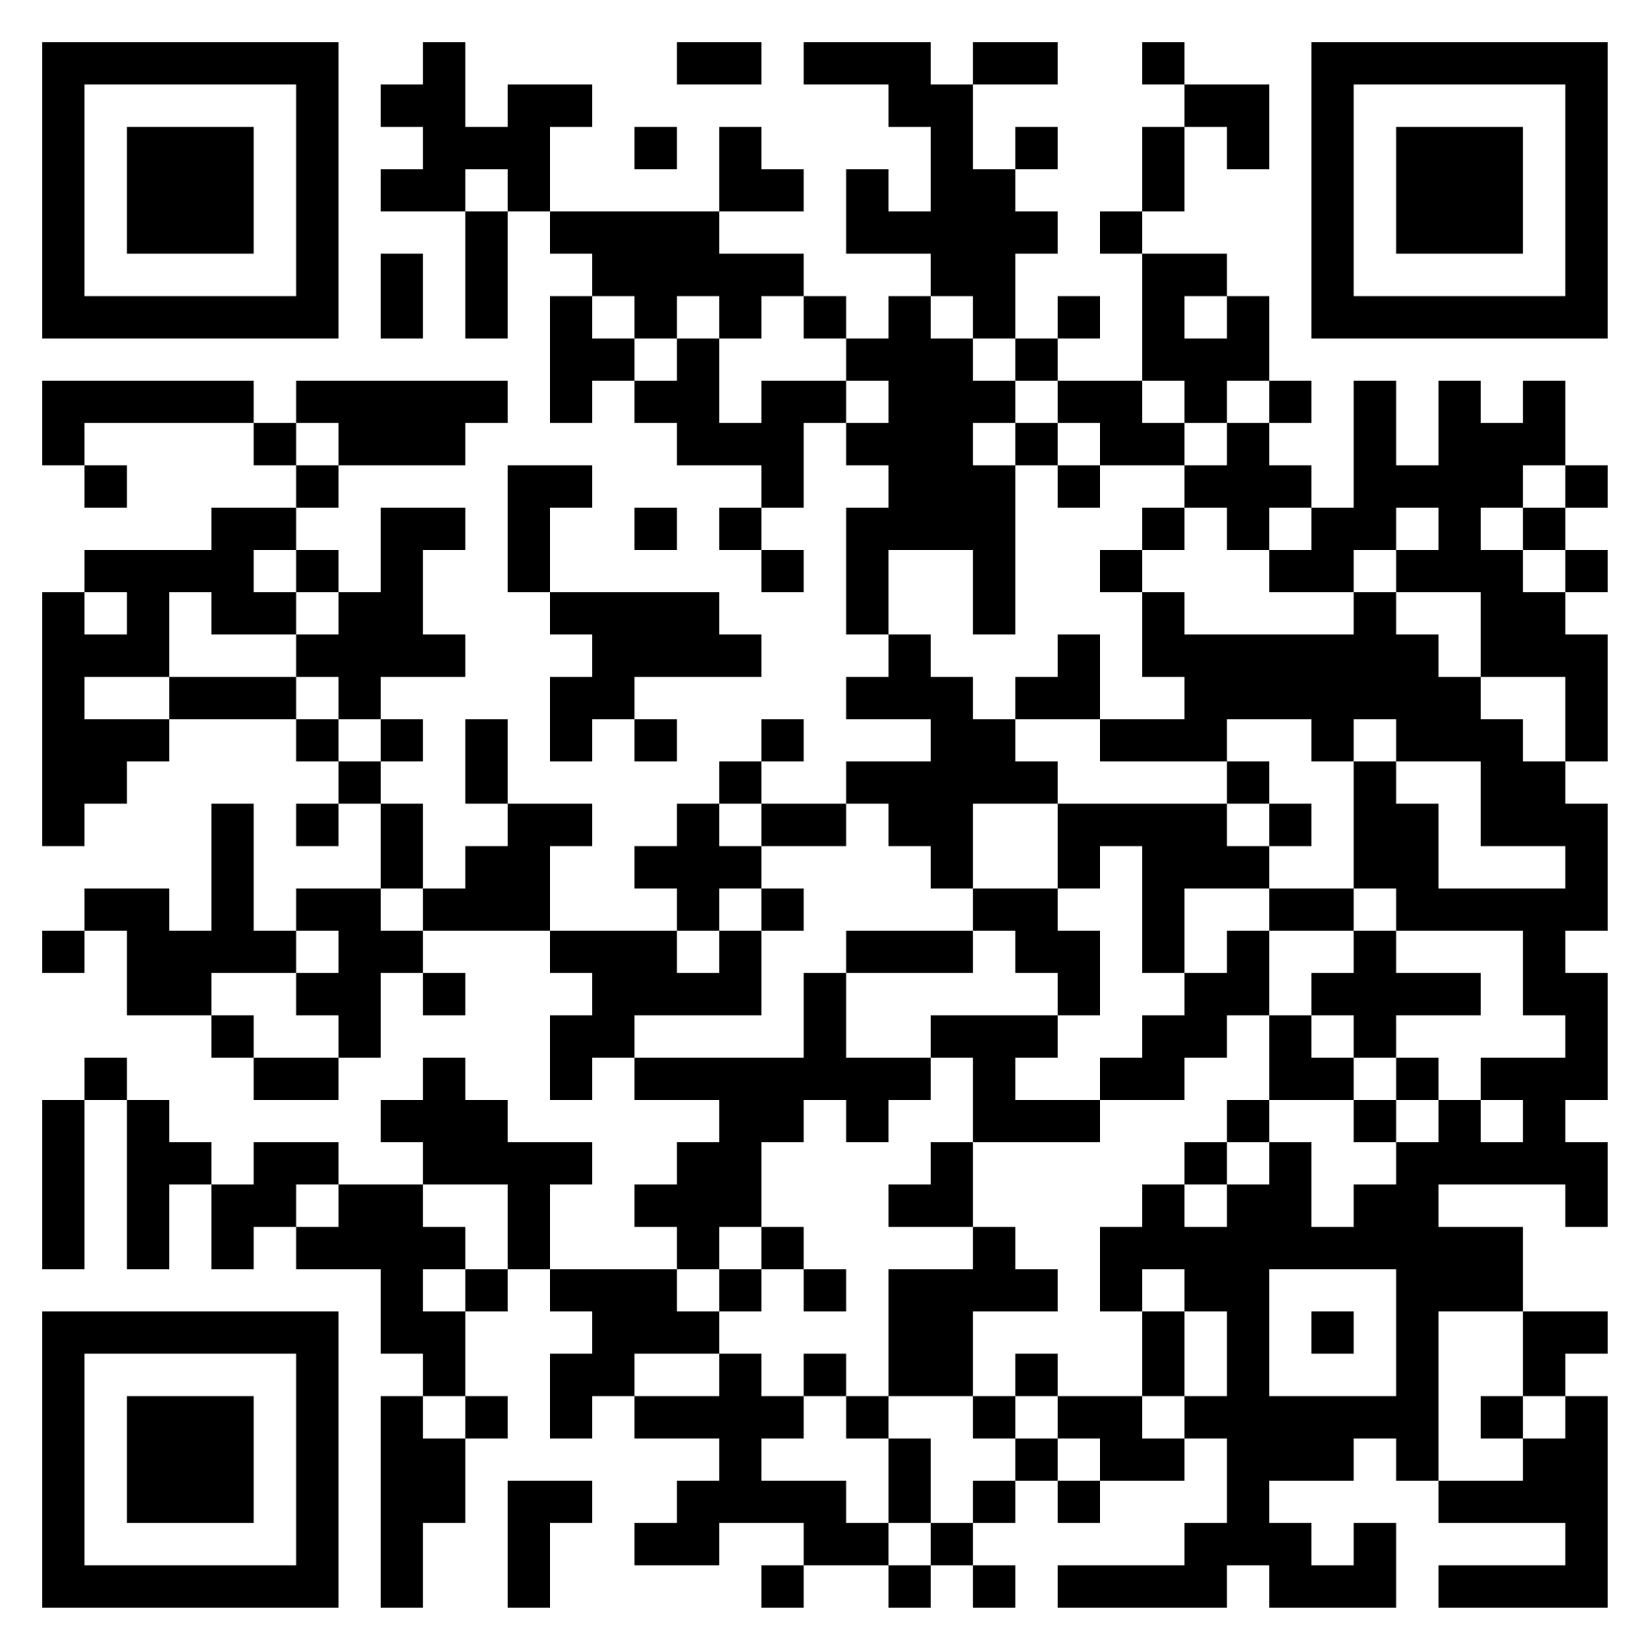


Inchlair ELC Centre
Follow Us on @Inchlairelcc.bsky.social
Introduction
The purpose of the annual Standards and Quality Report is to record the successes and achievements in delivering the improvement plan for 2025- 2026.
This report provides a helpful summary in the academic session from August 2025- June 2026 and outlines priorities for session 2026/27.
Our contextual analysis is summarised below:
Our Successes this Year
Gold Total Communication Environment award achieved
Working closely with Larbert High School to support learning across the generations. Pupils from the High school have delivered dance classes to almost all pupils within our 3-5 room.
One educator has successfully completed PEEP talk training and provided PEEP talk sessions for a number of families within the setting.
‘’Play is the highest expression of human development in childhood for it alone is the free expression of what is in a child’s soul’’ Friedrich Froebel.
At Inchlair ELCC our practice is underpinned by a Froebelian principled approach supporting children to learn through play and become autonomous learners. We believe children learn by doing and offer real life experiences to enhance children’s curiosity and engagement in their environment.
We recognise and acknowledge that parents and families are the most important people in a child’s life and aim to always work in partnership with families.
Froebelian principles
Inchlair ELCC link
Curriculum rationale
Froebelian Principles
Inchlair ELCC
Curriculum Rationale
Please scan QR Codes on right hand margin

Slide 2
Contextual Factors 2025-2026
Inchlair ELCC is located in the heart of Stenhousemuir, providing Early Learning and Childcare for children between the ages of 6 months to 5 years. The centre is open 8am to 6pm Monday to Friday all year. We provide placements for eligible 2’s and CARE placements as well as offering fee paying places for 2-year-olds. We offer placements for children aged 3- 5 years. The centre is registered to cater for 123 children throughout our 3 playrooms.
Community Demographic: People |  |  | Geographical and economic influences: Place
Our staff Head of Centre: Adele Hamilton PEYO: Claire Lord SEYO: 2 Clerical 12 EYOs, term time 8 EYOs, full year 3 ELCA 2 SFLA 2 Kitchen staff 3 Cleaning staff | Our children and families Registered for 123 children at any one time 113 children registered in Inchlair ELCC. 79 children are registered in 3-5 room. 34 children are registered in 2-3 room. Overall, 41% Girls & 59% Boys in 3-5 room Overall, 38% Girls & 62% Boys in the 2-3’s room 75% of our families have participated in home visits to begin transition from nursery to home 8 Children with ASN 7 Children with EAL SIMD: we range from 1-10 with highest percentage being SIMD 6, followed by SIMD 3. | Partners Collaborative work as part of Larbert Cluster EY Central Team. Various Professionals link Speech and Language Therapist/ Educational Psychologist/ Social Work YMI Gaelic PEEP PEEP Talk Programme Early Language Equity Woodlands Hub Pilot CLD Young Parents group Neighbourhood Group Play on Pedals | Amenities Woodland areas – 2 within walking distance Forest walks Play Park Local Library Community Centre Local shop, Chemist and café Local High School – Generation Project Local primary schools KLSB – Food Bank Community garden

Slide 3
Priority 1
By June 26 almost all children will demonstrate progress in their learning as identified in the Assessment Progression Framework.
Progress:
Almost all educators have participated in Planning for a Child Centred Play Pedagogy training with Cheryl Smyth – Early Years Teacher
Almost all educators are confident in writing evaluative statements which demonstrate children’s progress over time.
Almost all educators are recording high quality observations
Almost all children are demonstrating progress in most areas of their learning as identified within the APF.
Next Steps:
Develop approaches to planning which ensure consistency between 2-3 and 3-5 room.
Develop our approaches to intentional planning ensuring it is underpinned by the Froebelian principles
Continue to build on the Equity Project - develop approaches to rhyme and rhyming within both playrooms
Froebel
Fire Training
Woodwork
Sewing

Slide 4
Priority 2
By June 26, PEEP Talking and Listening Kit will be embedded across the setting.
Progress:
11 families participated in PEEP Talk for a 6-week period.
Almost all families who attended reported a 60% increase in their confidence supporting their child’s communication and language development after attending PEEP Talk.
Following attendance at PEEP talk, there was a 40% increase in almost all families understanding of the importance of making time for talking and listening to support their child’s communication and language.
Following attendance at PEEP talk, there was a 60% increase in almost all families understanding of the importance of songs and rhymes in supporting their child’s communication and language.
Parent Comments from PEEP talk:
What do you do differently to support your child’s communication & language development since attending the TALK sessions?
“I take my time when talking and playing with my child”
“I use a lot more eye contact”
“Be more in the moment and be responsive”
“I put my phone down more when they talk to me even when busy”
What have you enjoyed about the TALK sessions?
“Being creative and having fun every session”
“Having time to open up about concerns”
“Learning more about their communication”
“Learning communication is not just talking”
Next Steps:
Continue to offer PEEP talk sessions consistently throughout the 2026-2027 year
In response to family feedback, provide more opportunities for PEEP talk outdoors
PEEP
Stay
& Play
Baby Massage
Bookbug

Slide 5
Priority 3
By June 2026,100% of children will experience high quality transition adapted to their needs
Some children have attended transition bookbug visits to Larbert Village ELC
All children transitioning to Kinnaird Primary have participated in transition events
Children transitioning into Inchlair ELCC have all been invited to attend an initial stay and play visit in June 2026
All families are offered a home visit prior to their child transitioning to the setting.
Transition is sensitively planned in partnership with families to meet children’s individual needs e.g. increased settling in visits, settle visits over the summer period.
Children who do not attend during holiday periods have been invited to attend a settle back into nursery stay and play session prior to their return.
All families have been given the opportunity to attend stay and play sessions each Monday of the summer holidays to support keeping in touch during the holiday period.
Next Steps:
Develop approaches to transition between the 2-3 and 3-5 playroom.
Develop approaches to transition which are enhanced to meet the needs of children who require additional support.

Slide 6
Feedback
The staff are always so friendly and welcoming, nothing ever seems like too much trouble for them.
Great to have events like this (breakfast gathering) outside school hours.
I only get to look at my child’s folder during reviews, could electronic journals be considered.
Communication and handover could be improved.
Improvement Priorities 26/27
By June 2027, all educators will be confident in delivering intentional planning underpinned by the Froebelian principles to secure children’s progress.
By June 2027, all children will have equity of opportunity regardless of socio-economic background, disability, race or gender.
By June 2027, Up, Up and Away identifying stages toolkit and stages profile and strategy map will be used consistently and effectively by all educators to evidence children under 3’s progress over time

